Slide 1
The Rectangular Coordinate System
4.1
1. Determine the coordinates of a given point.
2. Plot points in the coordinate plane.
3. Determine the quadrant for a given coordinate.
4. Determine whether the graph of a set of data points is linear.

Slide 2
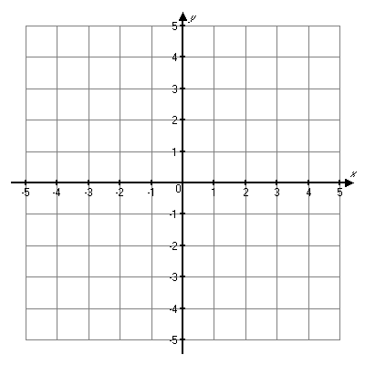
x-axis
y-axis
Quadrant II
Quadrant I
positive
negative
ordered pair
(x,y)
Quadrant III
Quadrant IV
origin
(0, 0)
quadrants
Use Roman numerals to identify quadrants.

Slide 3
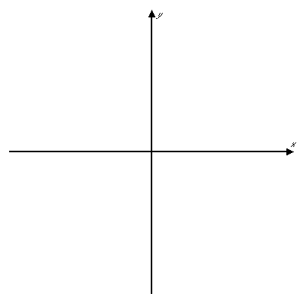
Use Roman numerals to identify quadrants.
Positive x; negative y
Quadrant II
Quadrant I
Negative x; negative y
(−, +)
(+, +)
Positive x; positive y
Copyright © 2007 Pearson Education, Inc. Publishing as Pearson Addison-Wesley
Quadrant III
Quadrant IV
Negative x; positive y
(−, −)
(+, −)

Slide 4
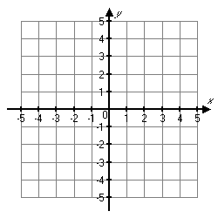
Write the coordinates for each point shown.
A
A:
(3, 5)
B
B:
(-3, 3)
C:
(0, 0)
C
D
D:
(0, -2)
E
F
E:
(2, -3)
F:
(-1, -4)

Slide 5
Plot and label each point. Name the quadrant.
B
Quadrant
A
A: (1,4)
I
B: (-3,5)
II
F
C: (3,-5)
IV
D: (-3,-5)
III
E
D
C
E: (0,-4)
y-axis
F: (-4,0)
x-axis

Slide 6
Linear versus Non-linear
In many problems data are listed as ordered pairs.
If we plot each pair of data as an ordered pair, we can see whether the points form a straight line.
If they form a straight line they are linear.
Points that do not form a straight line are nonlinear.

Slide 7
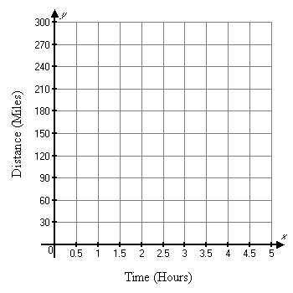
The following points show the path of an object over time. Plot the points with the time along the horizontal axis and the distance along the vertical axis. Then state whether the path is linear or nonlinear.
Time (hours) | Distance (miles)
0 | 0
1 | 62
2 | 124
3 | 186
4 | 248
The data points form a straight line; the path of the object is linear.

Slide 8

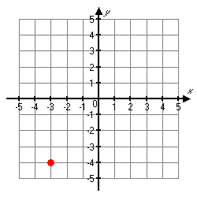
Identify the coordinates of the point shown below.
a) (–4, –3 )
b) (–3, –4)
c) (4, –3)
d) (–3, 4)
Copyright © 2007 Pearson Education, Inc. Publishing as Pearson Addison-Wesley
Slide 4- <number>

Slide 9
Identify the coordinates of the point shown below.
a) (–4, –3 )
b) (–3, –4)
c) (4, –3)
d) (–3, 4)
Copyright © 2007 Pearson Education, Inc. Publishing as Pearson Addison-Wesley
Slide 4- <number>

Slide 10
In which quadrant is the point (5, –2) located?
a) I
b) II
c) III
d) IV
Copyright © 2007 Pearson Education, Inc. Publishing as Pearson Addison-Wesley
Slide 4- <number>

Slide 11
In which quadrant is the point (5, –2) located?
a) I
b) II
c) III
d) IV
Copyright © 2007 Pearson Education, Inc. Publishing as Pearson Addison-Wesley
Slide 4- <number>

Slide 12
Graphing Linear Equations
4.2
1. Determine whether a given pair of coordinates is a solution to a given equation with two unknowns.
2. Find solutions for an equation with two unknowns.
3. Graph linear equations.

Slide 13
Determine whether the ordered pair is a solution for the equation.
y = 4x – 3
5 4(–3) – 3 Replace x with –3 and y with 5.
5 –12 – 3
5 ≠ –15 Because the equation is not true, (–3, 5) is not a
solution for y = 4x – 3.
(−3, 5) y = 4x – 3
?
=
?
=

Slide 14
To determine if a given ordered pair is a solution:
  1. Replace the variables in the equation with the
  corresponding coordinates.
  2. Verify that the equation is true.

Slide 15
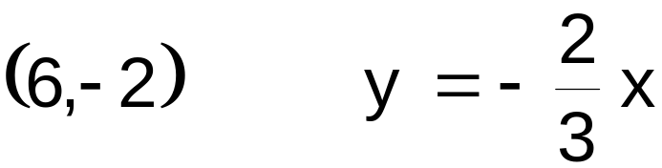
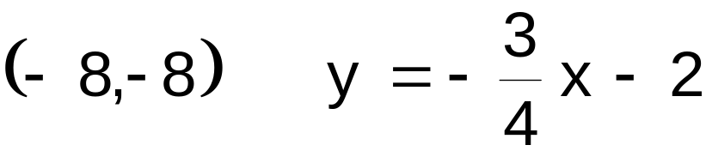
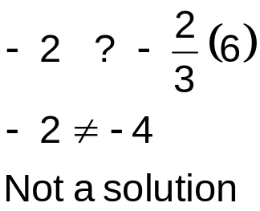
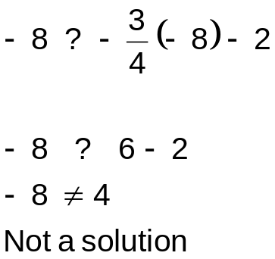
Determine if the given ordered pair is a solution to the given equation.
(2,3) x + 2y = 8
(2,1) 2x - y = 5
2+2(3) ? 8
2 + 6 = 8
Yes, a solution
2(2) – 1 ? 5
4 – 1 ? 5
3 ≠ 5
Not a solution
A: Solution
B: Not a solution

Slide 16
How do we find solutions for an equation with two unknowns?
Find three solutions for the equation.
  Replace one of the variables with a chosen value and then solve for the other variable.
Choose x = 0
4x + y = 5
4(0) + y = 5
y = 5
Solution (0, 5)
4x + y = 5
4x + y = 5
4(1) + y = 5
4 + y = 5
y = 1
Solution (1, 1)
Choose x = 2
Choose x = 1
4x + y = 5
4(2) + y = 5
8 + y = 5
y = –3
Solution (2, −3)

Slide 17
continued
The solutions can be summarized in a table:
There are an infinite number of correct solutions for a given equation in two variables.
x | y | Ordered Pair
0 | 5 | (0, 5)
1 | 1 | (1, 1)
2 | −3 | (2, −3)

Slide 18
To Find Solutions to Equations with Two Variables
  1. Choose a value for one of the variables (any value).
  2. Replace the corresponding variable with your
  chosen value.
  3. Solve the equation for the value of the other
  variable.

Slide 19
To Graph Linear Equations
  1. Find at least two solutions to the equation.
  2. Plot the solutions as points in the rectangular
  coordinate system.
  3. Connect the points to form a straight line.

Slide 20
Graph
4x + y = 5
x | y | Ordered Pair
0 | 5 | (0, 5)
1 | 1 | (1, 1)
2 | −3 | (2, −3)
4x + y = 5

Slide 21
Graph:
3x + y = 2

Slide 22
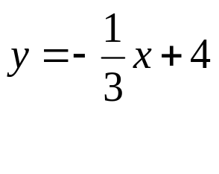
Graph:

Slide 23

Graph:

Slide 24
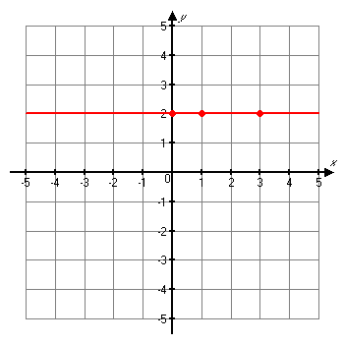
Example 5
y = 2
Graph
  Rewrite the equation
    0x + y = 2
y = 2
x | y | Ordered Pair
0 | 2 | (0, 2)
1 | 2 | (1, 2)
3 | 2 | (3, 2)

Slide 25
Horizontal Lines
If the equation has only a y, the line is horizontal.
y = c

Slide 26
Example 6
Graph
  Rewrite the equation
    x + 0y = -4
x = -4
x | y | Ordered Pair
-4 | 0 | (-4, 0)
-4 | 1 | (-4, 1)
-4 | 2 | (-4, 2)

Slide 27
Vertical Lines
If the equation has only an x, the line is vertical.
x = c

Slide 28
Which ordered pair is a solution of the equation 3x – 2y = –6?
a) (−4, 3)
b) (1, 5)
c) (2, 0)
d) (0, 3)
Copyright © 2007 Pearson Education, Inc. Publishing as Pearson Addison-Wesley
Slide 4- <number>

Slide 29
Which ordered pair is a solution of the equation 3x – 2y = –6?
a) (−4, 3)
b) (1, 5)
c) (2, 0)
d) (0, 3)
Copyright © 2007 Pearson Education, Inc. Publishing as Pearson Addison-Wesley
Slide 4- <number>

Slide 30
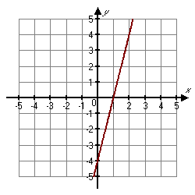
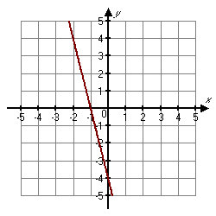
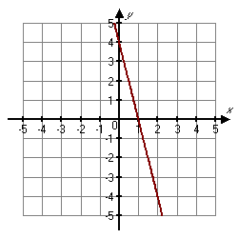
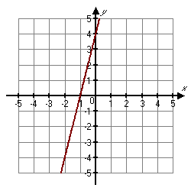
Graph 4x – y = –4
a)
b)
c)
d)
Copyright © 2007 Pearson Education, Inc. Publishing as Pearson Addison-Wesley
Slide 4- <number>

Slide 31
Graph 4x – y = –4
a)
b)
c)
d)
Copyright © 2007 Pearson Education, Inc. Publishing as Pearson Addison-Wesley
Slide 4- <number>

